Slide 1
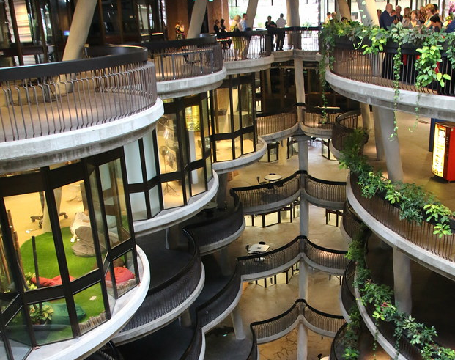
SC1015 INTRO TO DATA SCIENCE & ARTIFICIAL INTELLIGENCE
Group 5
Members: Tommy Ang Yi Long
Lim Shi Zeng
Wilfred Yeo Yu Zheng
This Photo by Unknown author is licensed under CC BY-SA-NC.
Notes:
(Dear friends?) Good Afternoon, Professor, and friends,
We are from group 5 and this is our presentation. Today we are doing a project regarding the prices of cars in Singapore. The topic of our project is: “Can the features of a car predict its manufacturer-suggested retail price which is MSRP(For Short)” As we know some basic information about it such as if it is manual or automatic, the different brands, number of seats and etc.

Slide 2
Content
Overview and problem statement
Dataset origins and its selection
Using Train test split data and the filtering tools used
Reasons for using selected tools
Chosen features to predict its MSRP
Applying different Correlation and Linear Regression model
The Features and chosen filters to assist in MSRP identification
Summary and Conclusion
Notes:
Here is the content of our project:
1) We first identify our problem statements and the possible features that affect car prices such as brand, engine, transmission type, year build and etc.
2) Next are the origins of the data set and the possible data structure and analysis tools we used to assist in our analysis.
3) The difference between Splitting the training set data and test set data and filtering some of its content plus the reasons for filtering
4) The reasons why we selected the analytical tools for our data set regressions.
5) Which Car brand chosen with their car features to predict their MSRP
6) Using the correlation model and Linear regression model to identify the relations
7) Best fit features to identify the best car brand and feature of a car to have a higher MSRP
8) Summaries and conclude

Slide 3

Can car features be used to predict its MSRP?

Slide 4
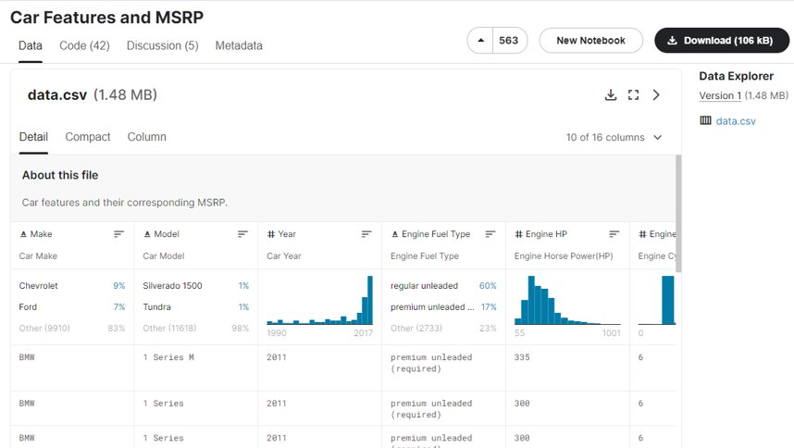
DATASET USED

Slide 5
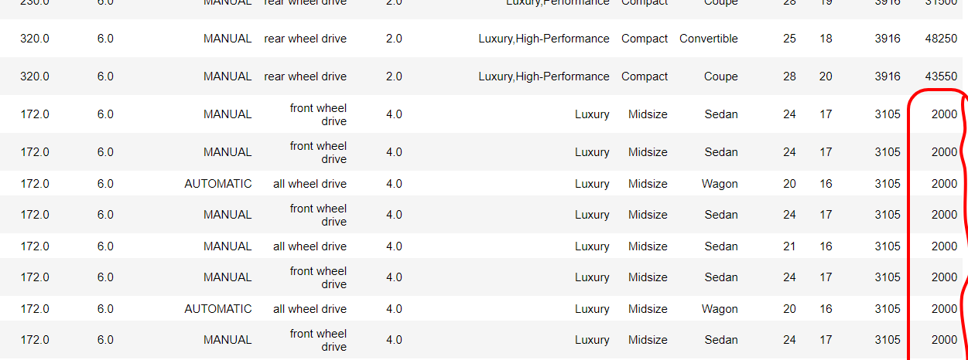
REASONS FOR FILTERING
2000 - 10000
Reasons for filtering
Can add the correlation chart on next slide
etc

Slide 6
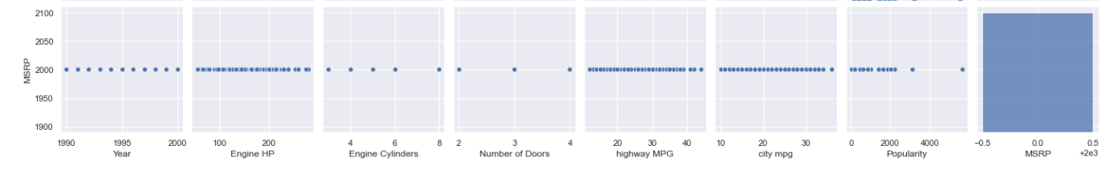
REASONS FOR FILTERING 2000 - 10000
Year EngineHP EngineCylinders NumberofDoors HighwayMPG CityMPG Popularity MSRP
MSRP

Slide 7
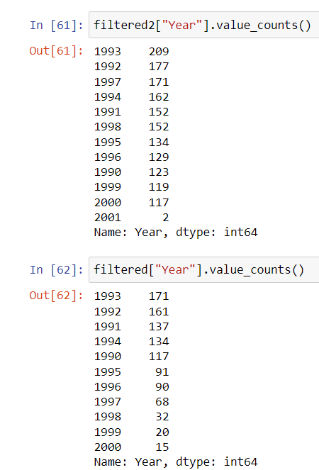
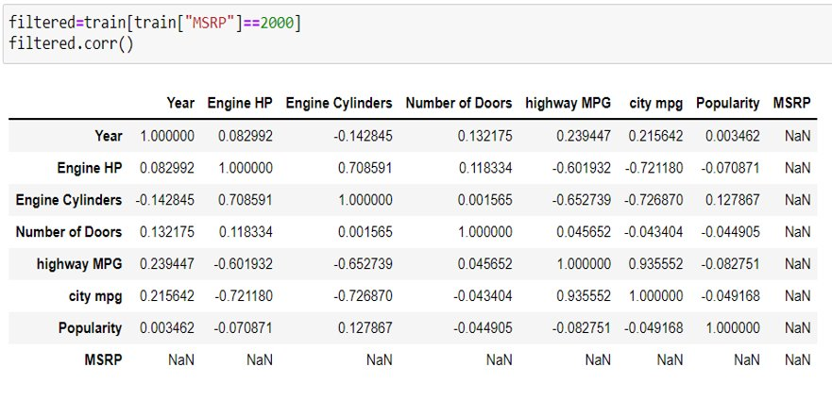
REASONS FOR FILTERING 2000 - 10000

Slide 8
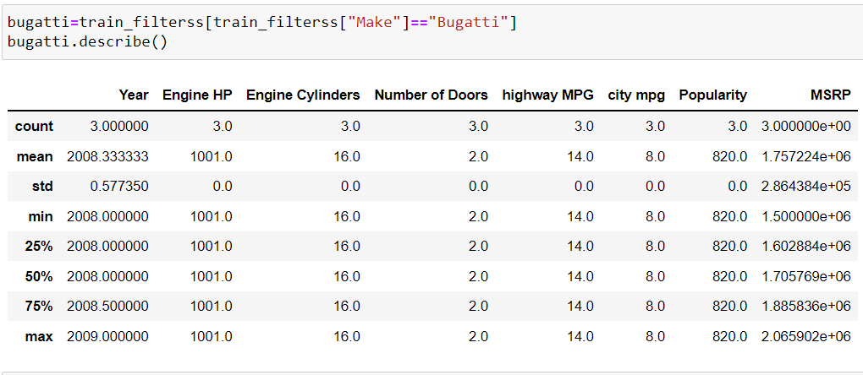
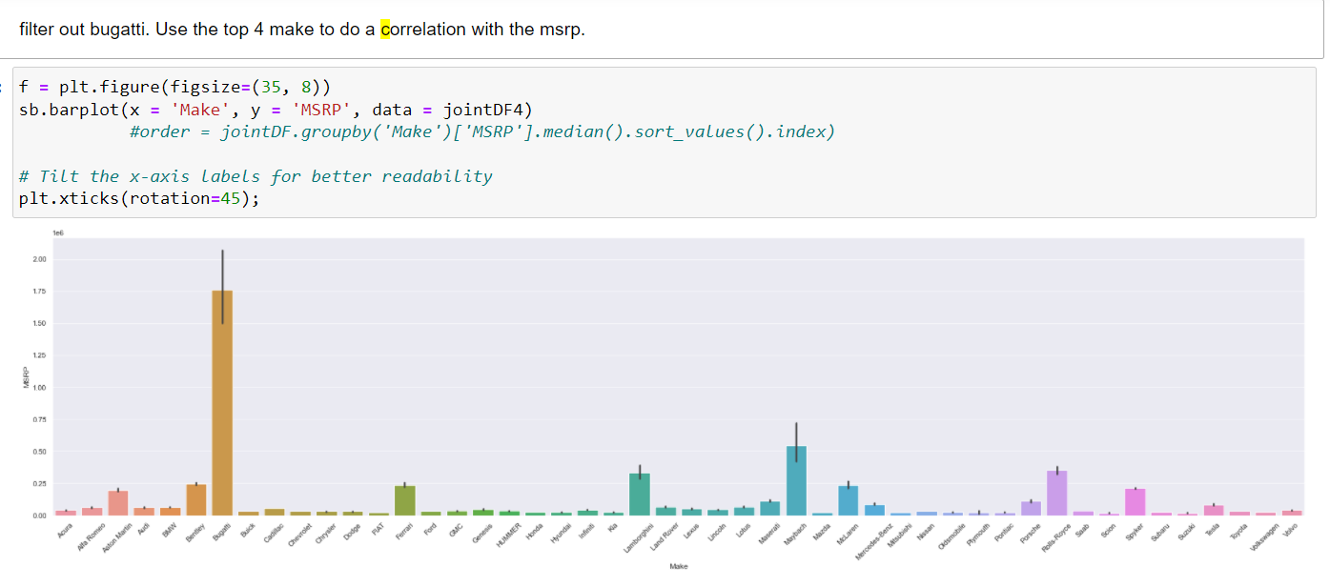
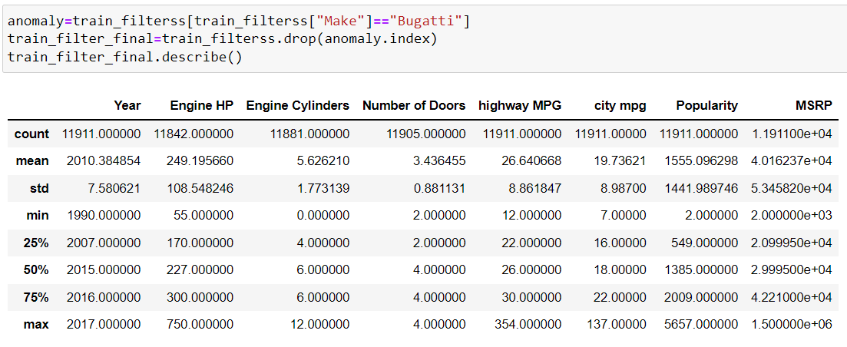
REASONS FOR FILTERING BUGATTI

Slide 9
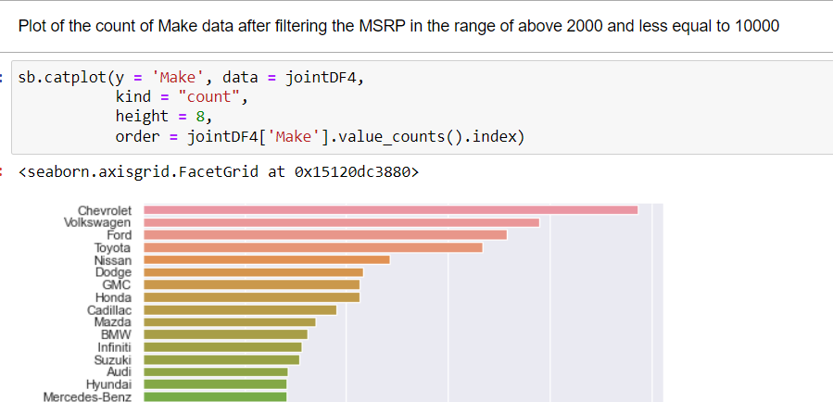
CHOOSING TOP 5 BRANDS

Slide 10
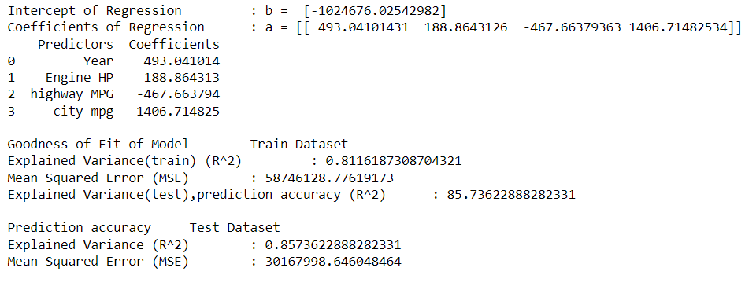
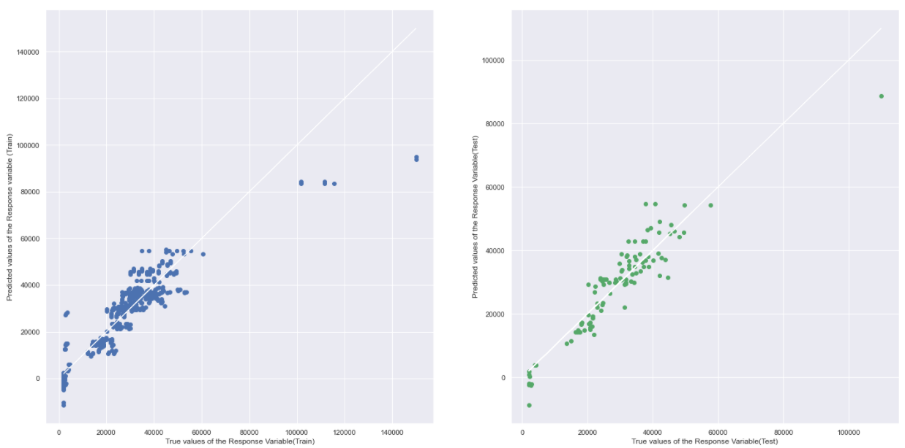
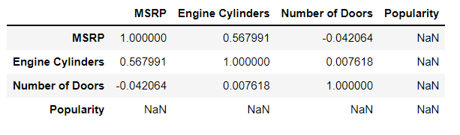
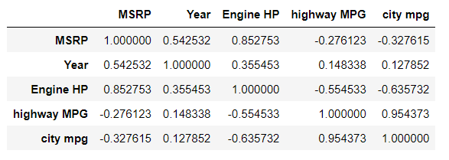
Linear Regression Lines
NISSAN
Correlation data for Car features
Lower Correlations
Higher Correlations

Slide 11
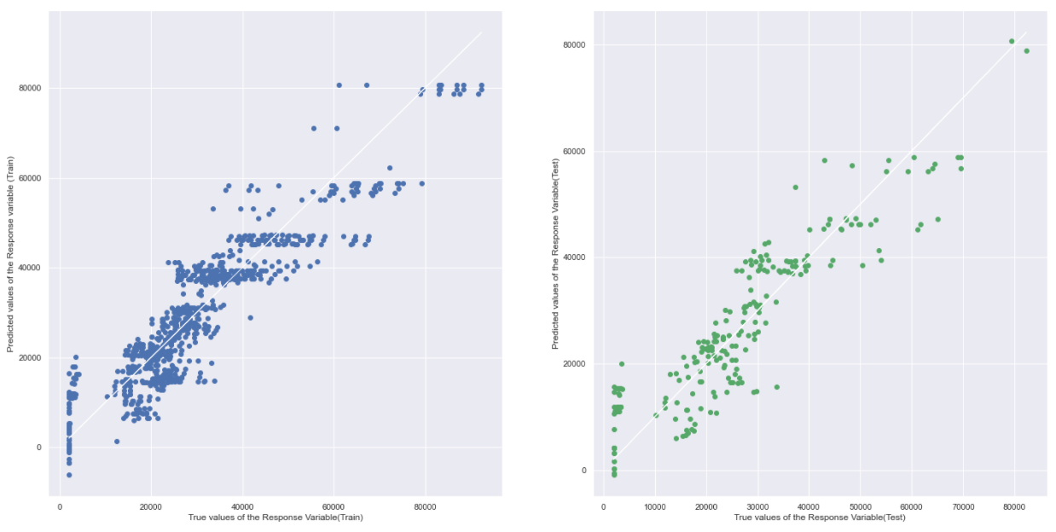
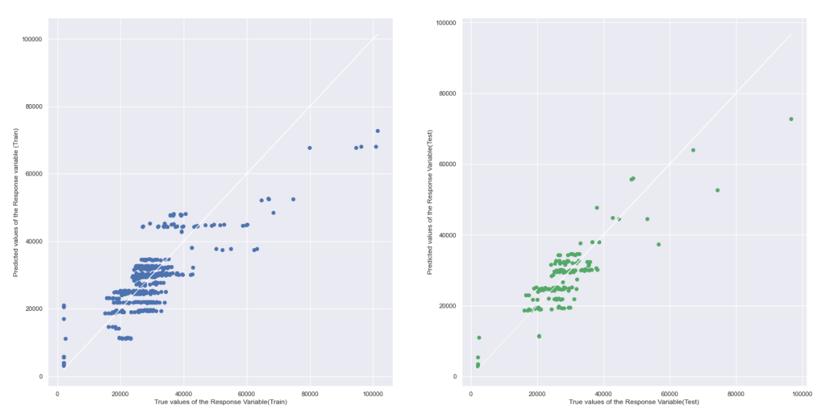
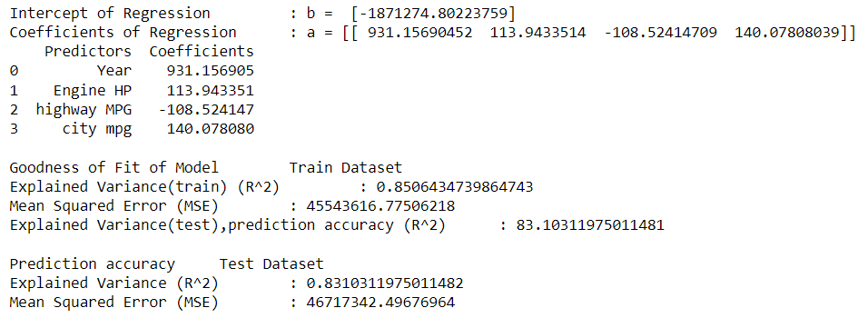
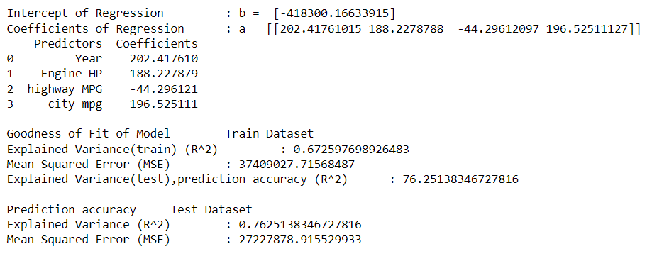
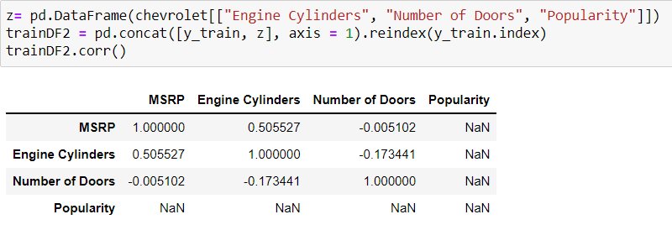
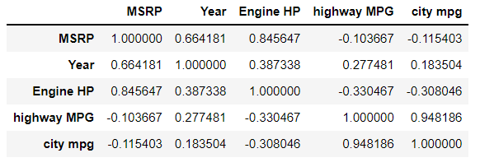
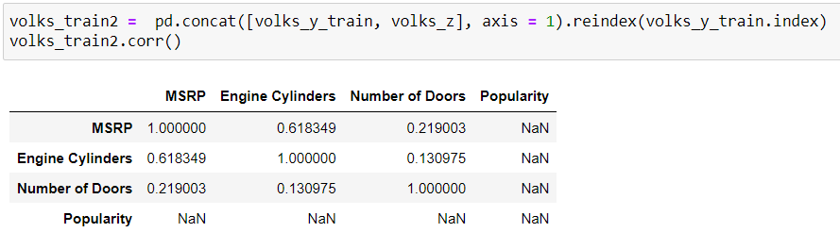
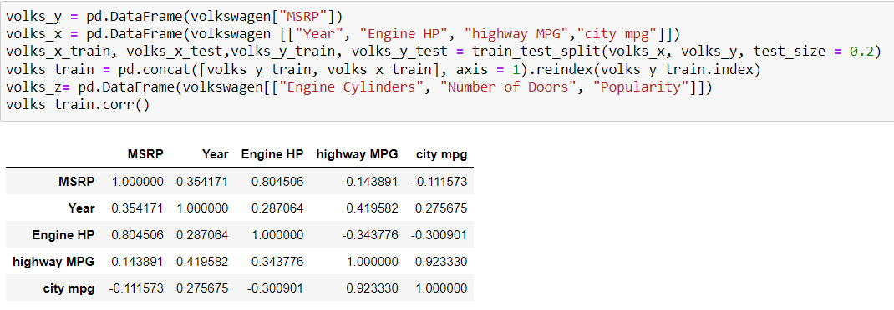
CHEVROLET
VOLKSWAGEN
Correlation data for Car features
Correlation data for Car features
Lower Correlations
Higher Correlations
Lower Correlations
Higher Correlations

Slide 12
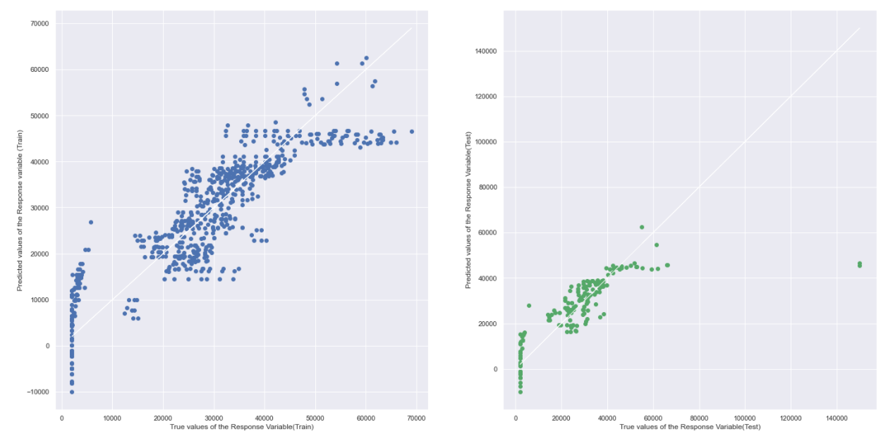
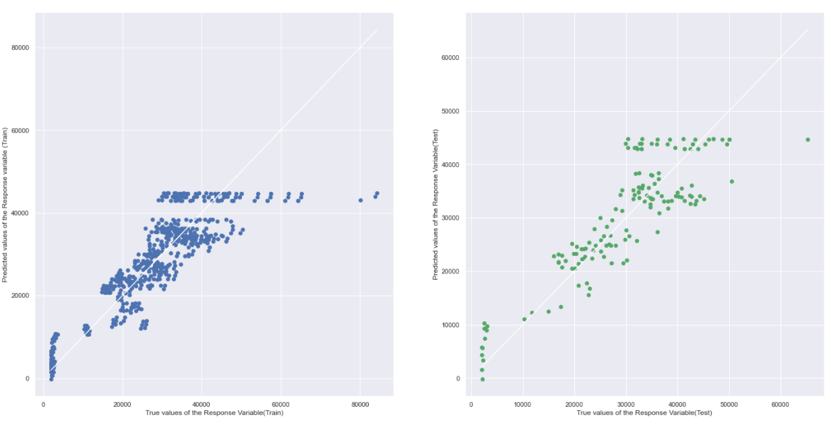
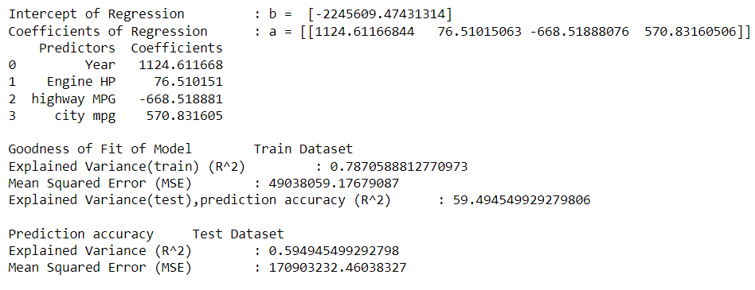
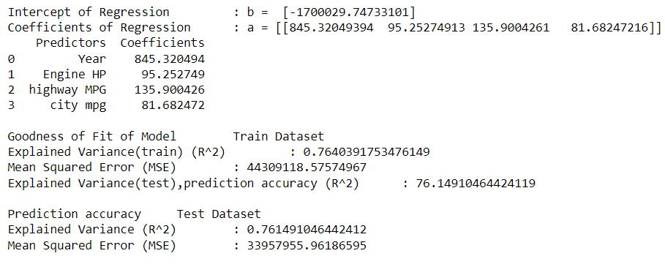
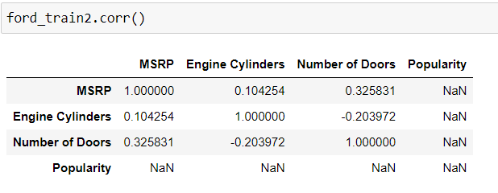
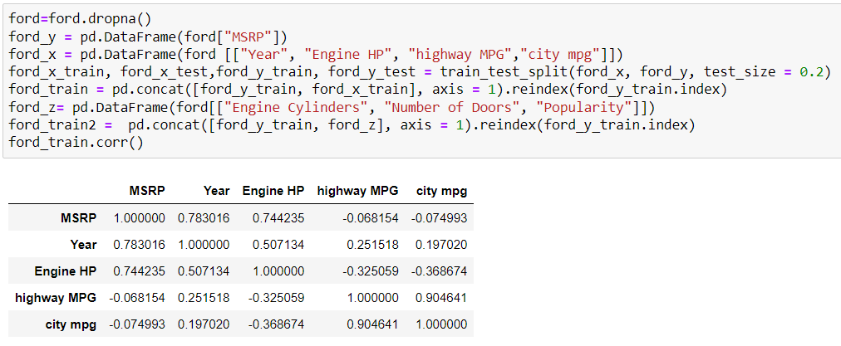
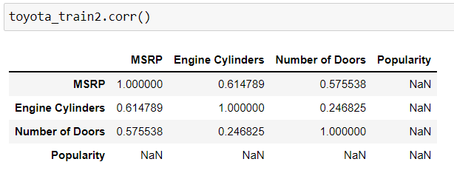
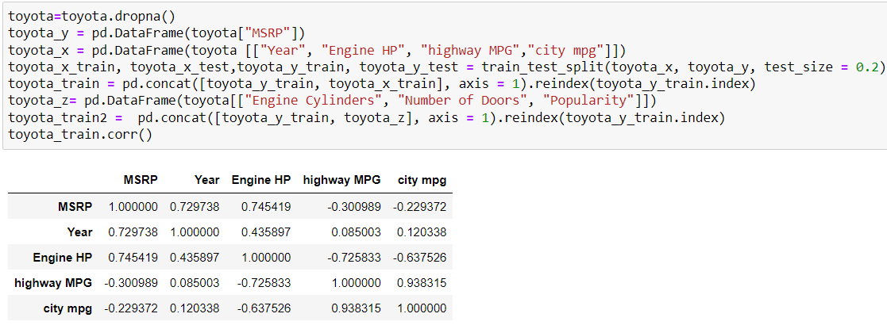
FORD
TOYOTA
Correlation data for Car features
Correlation data for Car features
Lower Correlations
Higher Correlations
Lower Correlations
Higher Correlations

Slide 13
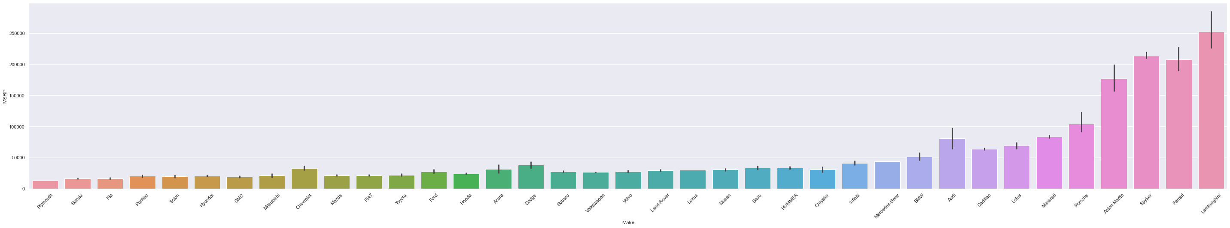

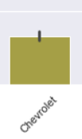
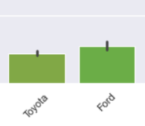


MANUAL

Slide 14
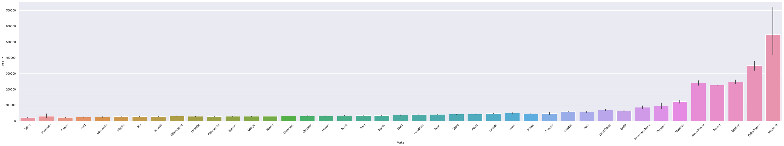



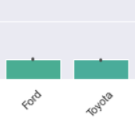
AUTOMATIC

Slide 15
Comparison between MSRP of Manual and Automatic
MANUAL
MSRP
Automatic is cheaper
AUTOMATIC

Slide 16
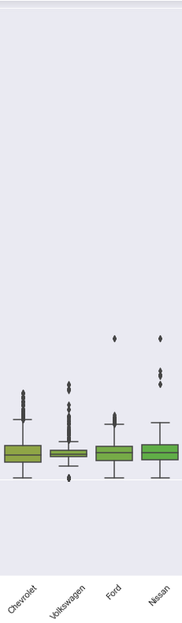
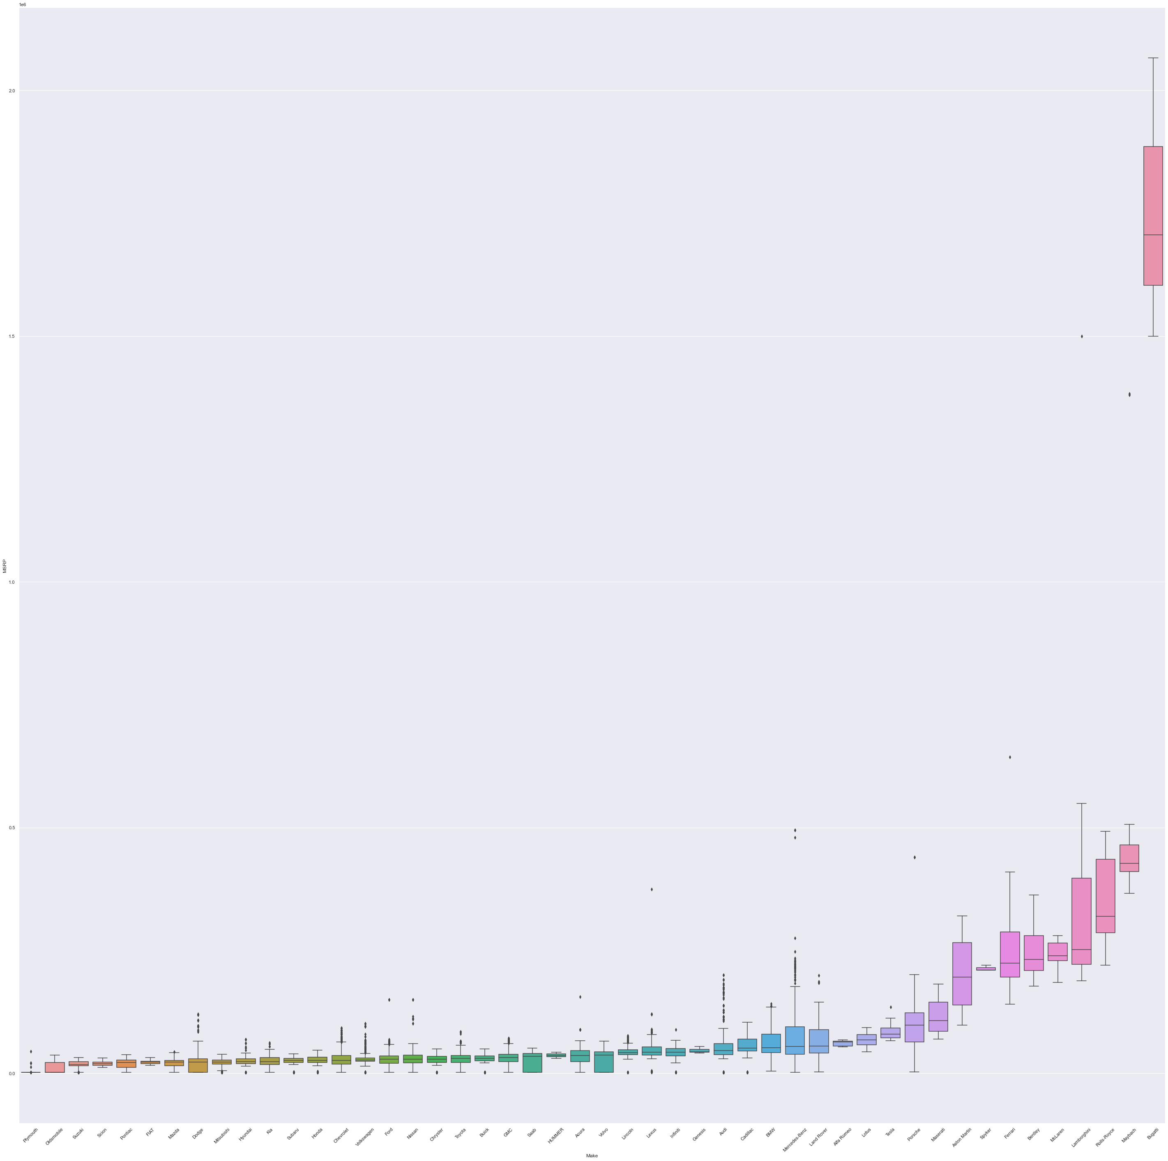
The average MSRP between the car brands
50000
0

Slide 17
Conclusion
Car Brand and Engine HP etc.
Bar Plot, Cat Plot etc.
Anomalies, redundant data etc.
Real World Context

Slide 18


Slide 19
References
CooperUnion. (2017). Car Features and MSRP[Dataset]
https://www.kaggle.com/datasets/CooperUnion/cardataset

Slide 20
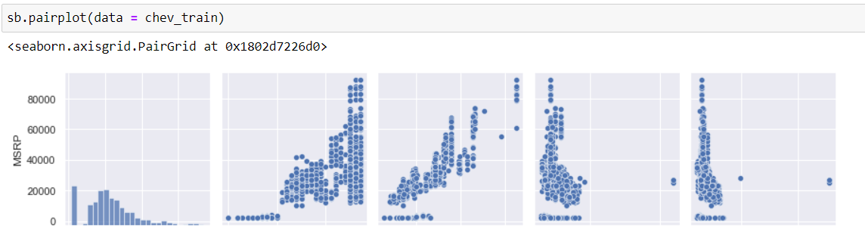
CHEVROLET
MSRP
MSRP Year EngineHP HighwayMPG CityMPG

Slide 21
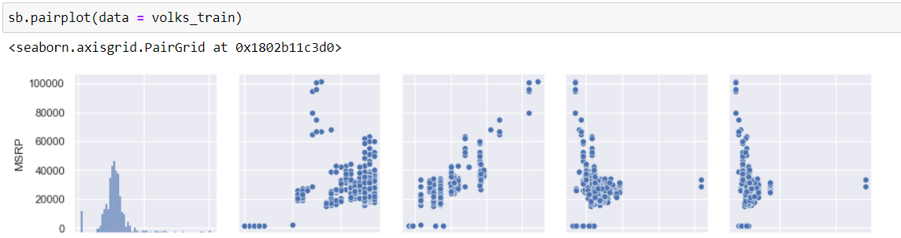
VOLKSWAGEN
MSRP
MSRP Year EngineHP HighwayMPG CityMPG

Slide 22
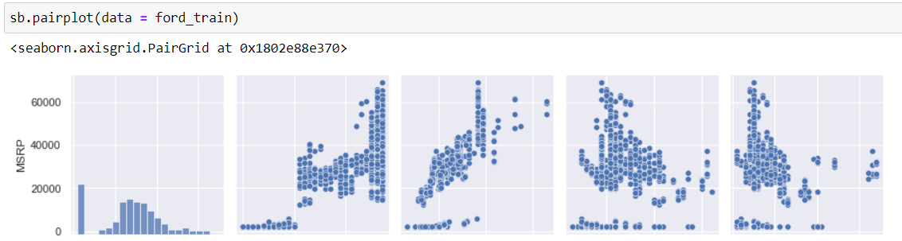
FORD
MSRP
MSRP Year EngineHP HighwayMPG CityMPG

Slide 23
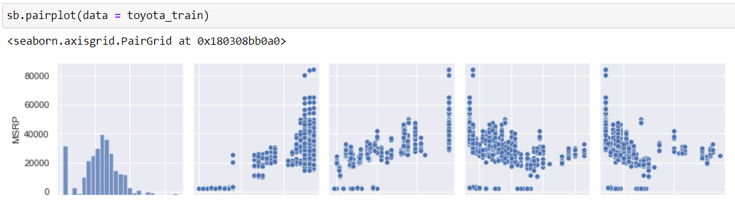
TOYOTA
MSRP
MSRP Year EngineHP HighwayMPG CityMPG

Slide 24
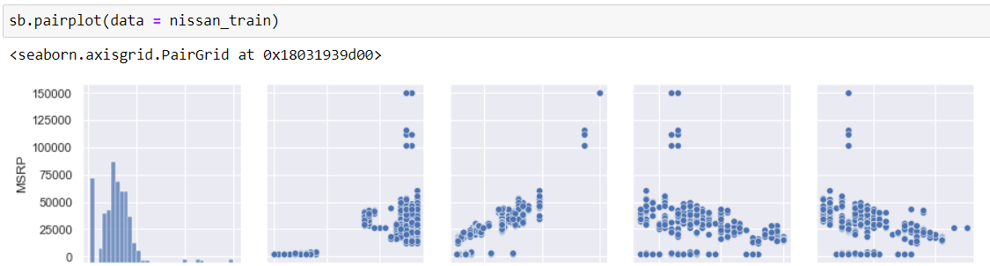
NISSAN
MSRP
MSRP Year EngineHP HighwayMPG CityMPG

